Slide 1
DIRECTORY SERVICES
LDAP

Slide 2
Mohammed Asik - 093947
Raavi Vinay Kumar - 093992
Madhuri Sanapala - 093963
Rohit Hurkadli - 094048
Bindu Shree - 093941
Priyal Potnis - 093979
Subham - 093988

Slide 3
X.500 Directory Service
The X.500 directory service is a global directory service.
X.500 is a series of computer networking standards covering electronic directory services.
The X.500 series was developed by CCITT, and first approved in 1988.
Its components cooperate to manage information about objects such as countries, organizations, people, machines, and so on in a worldwide scope.
It provides the capability to look up information by name and to browse and search for information.

Slide 4
The different types of protocols of X.500:
DAP (Directory Access Protocol)
DSP (Directory System Protocol)
DISP (Directory Information Shadowing Protocol)
DOP (Directory Operational Bindings Management Protocol)
These protocols used in the OSI networking stack.
A number of alternatives to DAP were developed to allow Internet clients to access the X.500 Directory using the TCP/IP networking stack.
The most well-known alternative to DAP is Lightweight Directory Access Protocol (LDAP).

Slide 5
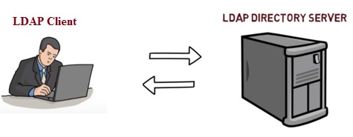
LDAP (Lightweight Directory Access Protocol)
Lightweight Directory Access Protocol uses client-server architecture.
It is used to manage and access distributed directory over IP network.
It is similar to telephone directory containing contact numbers and addresses of the subscribers.
It provides directory service with systematic set of records organized in hierarchical structure.

Slide 6
LDAP (contd..)
Clients may be directly controlled by individuals, embedded in applications or "agents".
It is useful when integrating multiple directory services.
To commence LDAP session, client needs to connect with server (called as "Directory System Agent").
After connection is established, client and server can exchange the information or data.
Various operations can be performed on LDAP such as Add, Bind, Delete, Modify, Unbind etc.
The default TCP port for LDAP is 389

Slide 7
Basic functionality of LDAP
The main benefit of using LDAP is that information for an entire organization can be consolidated into a central repository.
For example, rather than managing user lists for each group within an organization, LDAP can be used as a central directory accessible from anywhere on the network. And because LDAP supports Secure Sockets Layer (SSL) and Transport Layer Security (TLS), sensitive data can be protected from prying eyes.

Slide 8
Advantages of LDAP
Global naming model ensures unique entries.
It allows use of multiple independent directories.
It is extensible to meet future/local requirements.
It runs over TCP/IP and SSL directly.
It has wider support across the industries.
The protocol is based on existing deployed technologies.
LDAP is used by many services like TCP and DNS.
It is open source protocol with very flexible architecture.
LDAP is automated and hence updating of the same is much easier unlike DNS.

Slide 9
Disadvantages of LDAP
It requires directory servers to be LDAP compliant for service to be deployed.
LDAP is difficult but rarely employed unlike DNS which is more easy to use and widely employed.
An LDAP server cannot be its own client.
Setting up and managing an LDAP naming service is more complex and requires careful planning

Slide 10
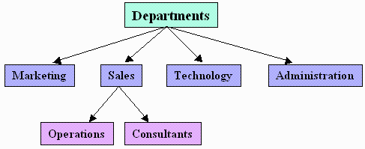
DIRECTORY STRUCTURE
The primary purpose of the directory services is to provide systematic set of records usually organized in a hierarchical structure.
9

Slide 11
Root Node
Branch Node
Leaf Nodes

Slide 12
EXAMPLE.COM
IT
sales
Micheal Yee
Rick Francis
DN Kulkarni
W cooley
J Jones

Slide 13
LDAP Directory Structure
An LDAP directory has a tree structure.
All entries (called objects) of the directory have a defined position within this hierarchy.
This hierarchy is called the directory information tree (DIT).
12

Slide 14
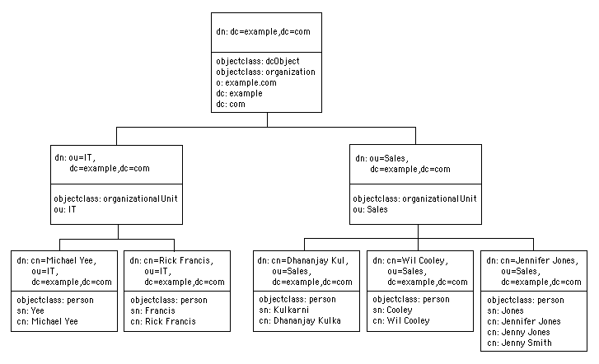
Directory Information Tree (DIT)

Slide 15
OPERATIONS OF LDAP
Add operation:
Used to create a new entry in a directory server.
Bind operation:
Used to authenticate a user and change the identify of the associated connection.
Modify operation:
Used to alter the contents of an entry in a directory server.
Delete operation:
Used to retrieve entries that match a provided set of criteria.
Unbind operation:
Used to close the connection to the directory server.

Slide 16
OPERATIONS OF LDAP(contd..)
Abandon operation:
An abandon operation may be used to request that the server stop working on an operation that the client had previously requested.
Compare operation:
The Compare operation allows a client to request the comparison of an entry attribute against a specific value.
Extended operation:
The Extended operation allows a client to request an operation that may not be defined in the current RFCs but is available on the server.
Search operation:
The Search operation is used to request a server to return, subject to access controls and other restrictions, a set of entries matching a search filter.
Modify DN operation:
The ModifyDN operation allows a client to change the Relative Distinguished Name (RDN) of an entry or to move an entry in the LDAP directory. 15

Slide 17
Configuring LDAP on windows 2012 server

Slide 18
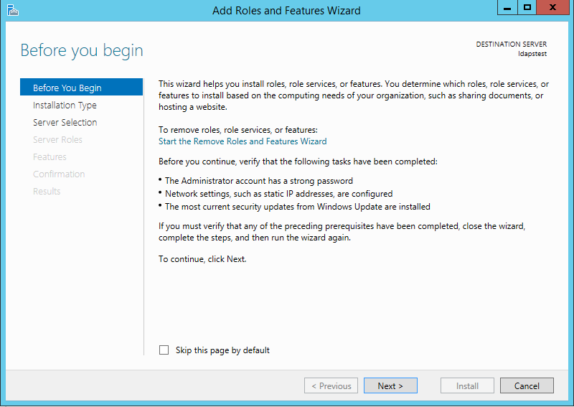
Click on Start --> Server Manager --> Add Roles and Features. Click Next.

Slide 19
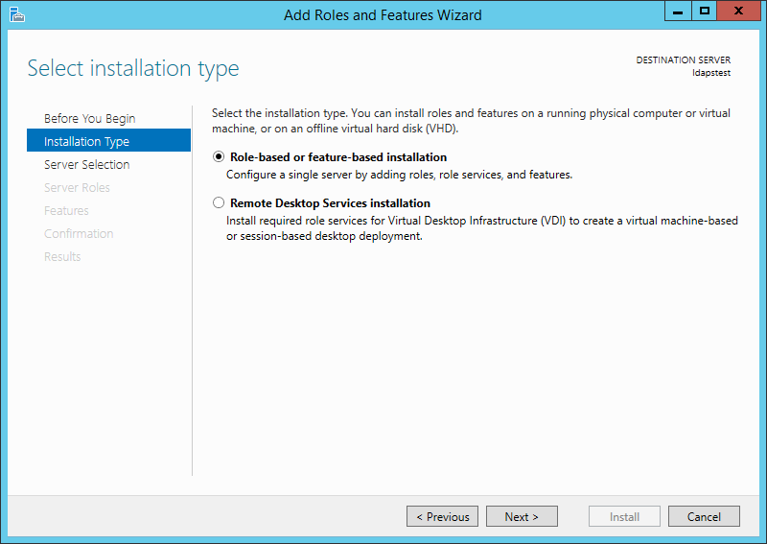
Choose Role-based or feature-based installation. Click Next.

Slide 20
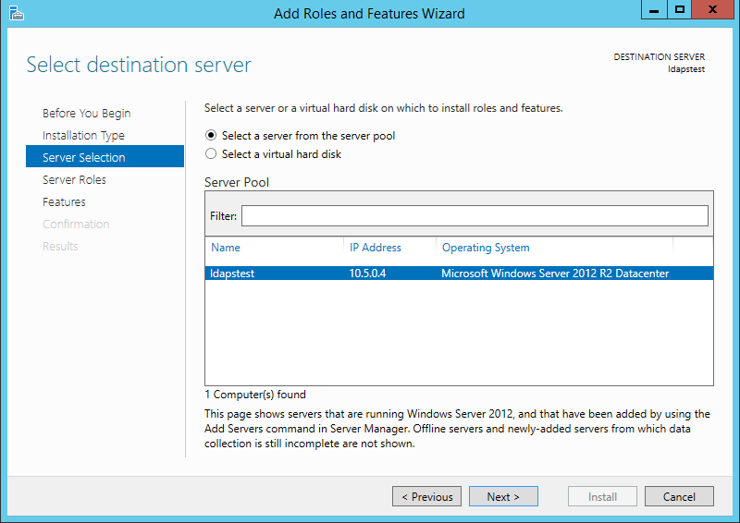
Select ldapstest server from the server pool. Click Next.

Slide 21
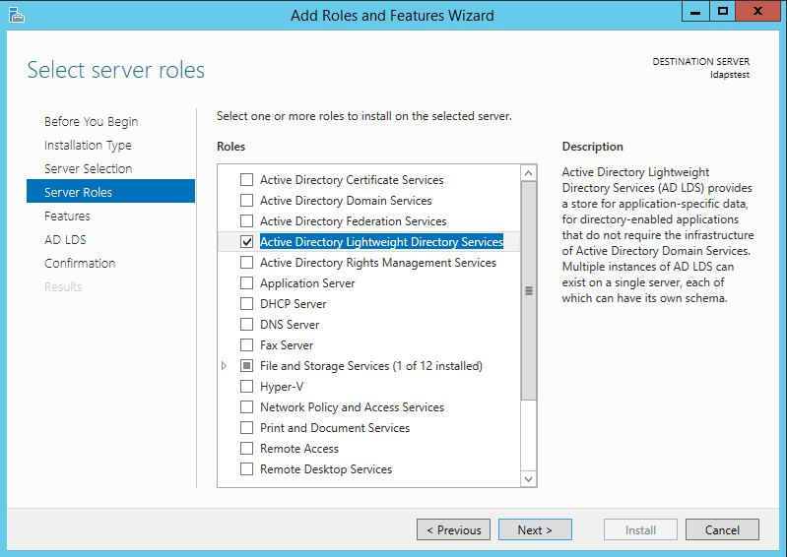
Mark Active Directory Lightweight Directory Services from the list of roles and click Next.

Slide 22
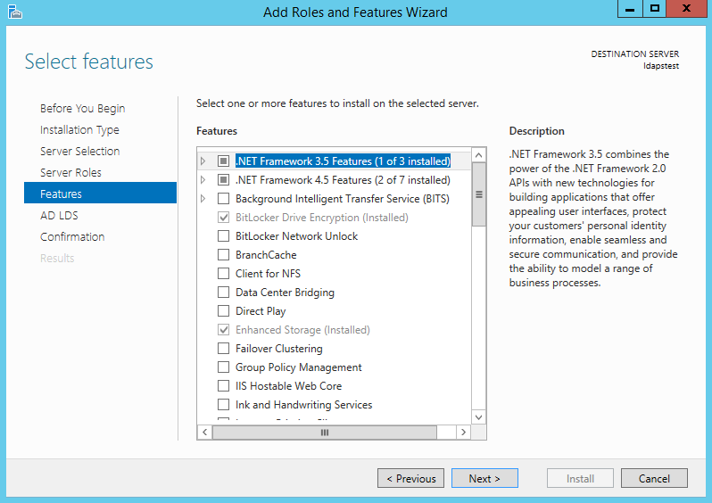
From the list of features, choose nothing – just click Next.

Slide 23
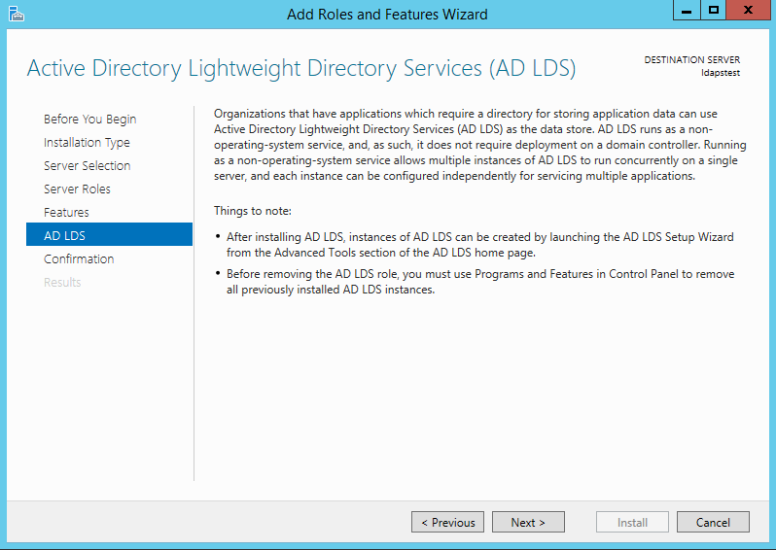
Click Next.

Slide 24
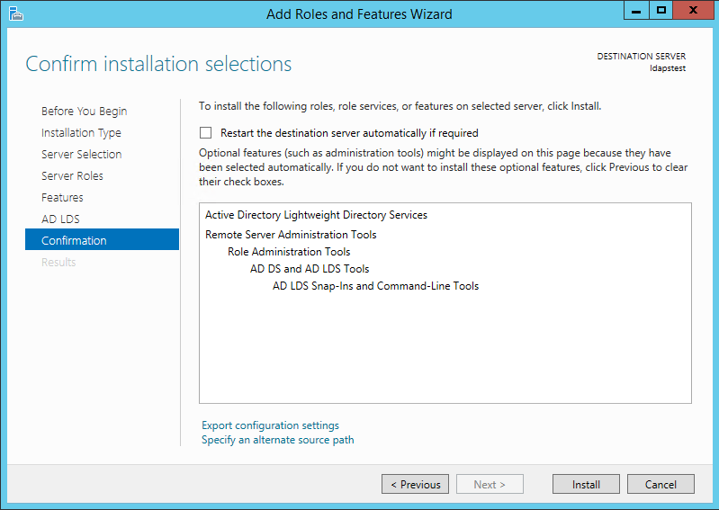
Click Install to start installation.

Slide 25
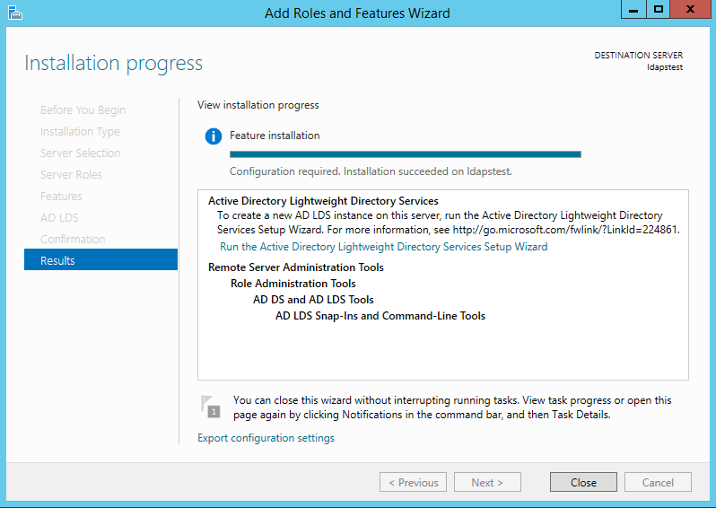
Once installation is complete, click Close.

Slide 26
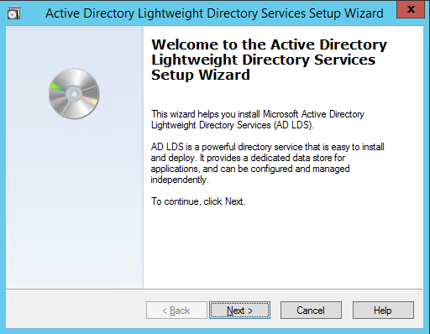
Now we have successfully set up AD LDS Role. Let us create a new AD LDS Instance “CONTOSO” using the wizard.
Click the “Run the Active Directory Lightweight Directory Services Setup Wizard” in the above screen. And then Click Close.

Slide 27
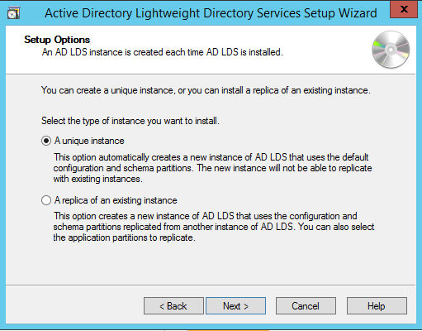
Choose Unique Instance since we are setting it up for the first time.

Slide 28
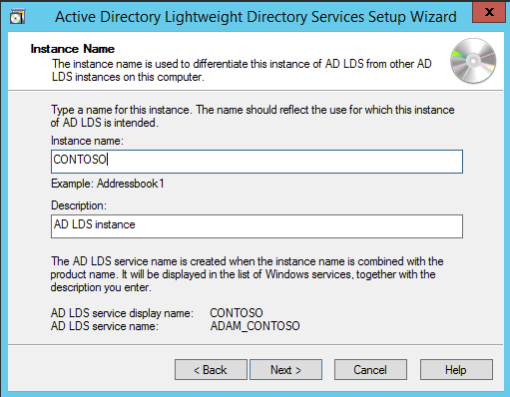
Type “CONTOSO” in Instance Name and click Next.

Slide 29
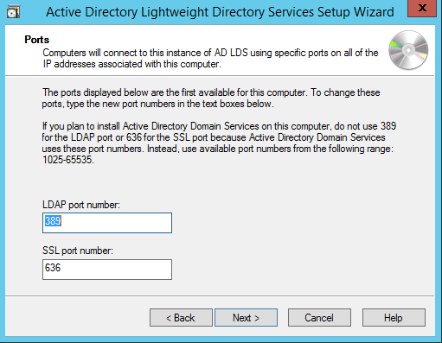
By Default, LDAP Port is 389 and LDAPS port is 636, let us choose the default values - click Next.

Slide 30
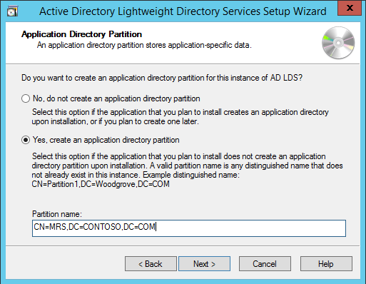
Create a new Application Directory Partition named “CN=MRS,DC=CONTOSO,DC=COM”. Click Next..

Slide 31
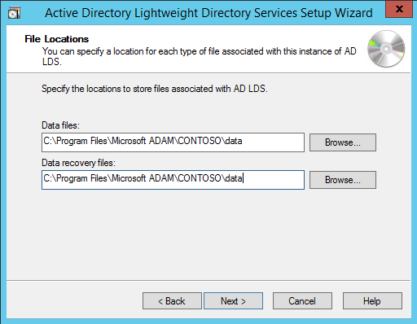
Using the default values for storage location of ADLDS files- Click Next.

Slide 32
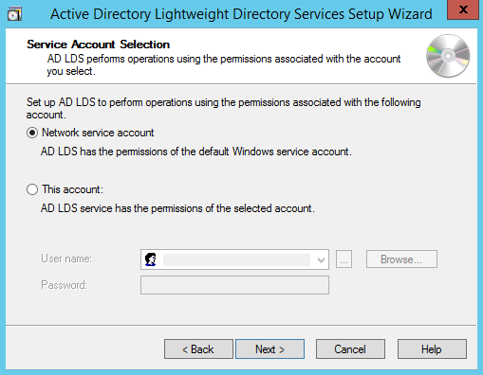
Choosing Network Service Account for running the AD LDS Service.

Slide 33
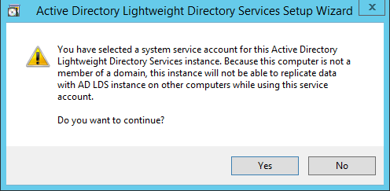
You will receive a prompt warning about data replication. Since we are using a single LDAP Server, we can click Yes.

Slide 34
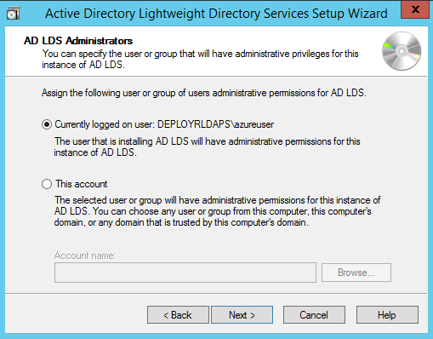
Choosing the currently logged on user as an administrator for the AD LDS Instance. Click Next.

Slide 35
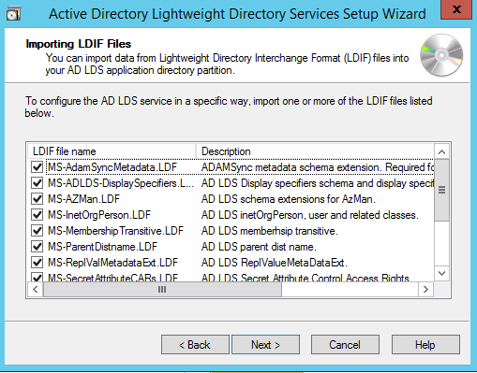
Mark all the required LDIF files to import (Here we are marking all files). Click Next

Slide 36
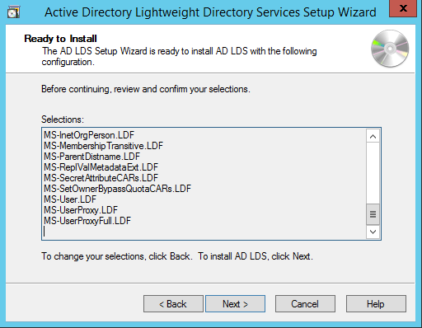
Verify that all the selections are right and then Click Next to confirm Installation.

Slide 37
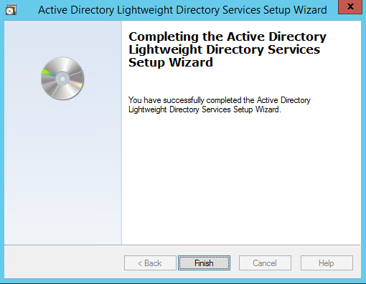
Once the instance is setup successfully, click Finish.

Slide 38
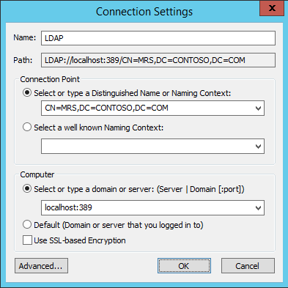
Now let us try to connect to the AD LDS Instance CONTOSO using ADSI Edit. Click on Start --> Search “ADSI Edit” and open it. Right Click on ADSI Edit Folder (on the left pane) and choose Connect To.. . Fill the following values and Click OK

Slide 39
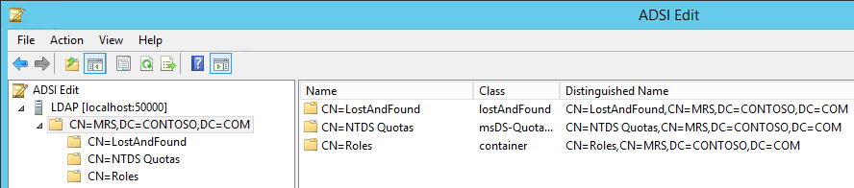
If the connection is successful, we will be able to browse the Directory CN=MRS,DC=CONTOSO,DC=COM :

Slide 40
Thank You

